Slide 1
An Investigation of Bounding Flight for UAVs
Kenneth Toro
Advisor: Dr. Lance Traub
Embry Riddle Aeronautical University
University of Arizona
April 2010

Slide 2
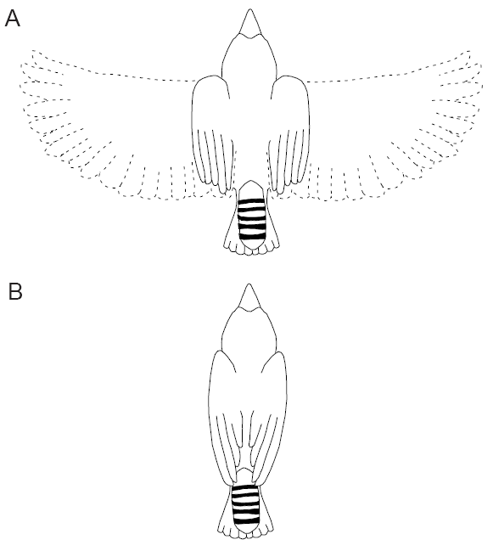
Bounding Flight of Birds
Bounding is an intermittent retraction of wings.
Exclusive to small birds (less than 260 grams)
Theories for bounding flight:
  Fixed Gate/Gear
  Reduction of power required
Figure: Bounding Flight of Birds
(Source: Tobalake, 1999)

Slide 3
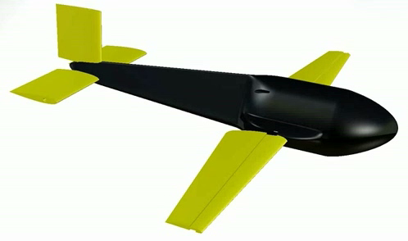
Wind Tunnel Model
Table: Test Article Parameters
Parameter | Value
Span (in.) | 24.1
Planform Area (in²) | 60.0
Reference Chord (in.) | 2.33
Aspect Ratio | 9.62
Wind Tunnel Test were conducted at Reynolds number of 150,000 and 85,000 (45 m/s and 25 m/s).
A 32 in. by 45 in. closed circuit wind tunnel was used.
A 6-component pyramidal balance was used to measure force data.

Slide 4
Wind Tunnel Results

Slide 5
Power Required

Slide 6
Bounding Simulation
Flight Path
Wings Retracted
Desired Alt.
Wing Extended
Figure: Desired Flight Bounding Flight Path
Thrust is the only variable.
Angle of Attack assumed to be constant.
Weight is assumed to be 0.7 kg.
Initial velocity was 25 m/s.

Slide 7
Bounding Simulation Results
Higher thrust while wings are extended leads to increase in the amplitude of oscillation.
Higher thrust while wings are retracted leads to an increase in energy used.
Bounding had a higher use of energy than steady level flight.

Slide 8
Conclusion and Recommendations
No performance improvement was achieve by bounding flight.
Power required at high speeds can be reduced by high wing sweep.
High wing sweep can improve gust alleviation.
A redesign of the fuselage can reduce the body drag of the model.

Slide 9
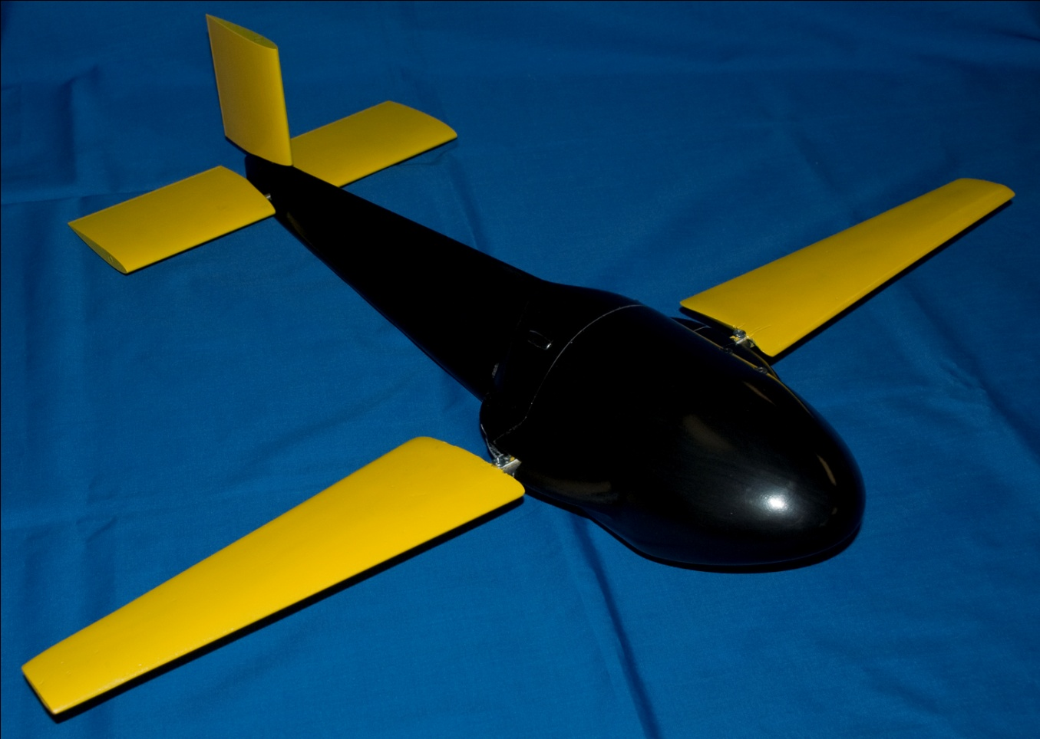
Questions?
Drago-B

